Slide 1
ILLICIT MONITOR
Period Ending May 27, 2019
Date: June 21, 2019

Slide 2
METHODOLOGY
What?
Continuous Online Tracking study
Adult smokers
(At least 19 years and 7 months old)
Who?
When?
Current reporting period = June 2018 – May 2019
(period ending May 27, 2019)
Where?
Ontario (sample size = ~ 500 per month)
Note: Generally, people tend to under-report socially undesirable beliefs, but may also over-report behaviours that are socially desirable. When thinking about the validity of the online methodology in capturing illicit tobacco usage, the online methodology actually provides a certain anonymity to the respondents that favours more truthful reporting relative to an interviewer administered phone survey.

Slide 3
ONTARIO ILLICIT SUMMARY (Past 12 Weeks): (P7D Share: 38%, TVU: 26%)
Overall in Ontario we are seeing a strong illicit performance in the most recent 12 weeks, driven by a seasonal upswing that we typically see in Q2
GTA illicit is back up close to 2017 levels after having dropped down in 2018.
 | P7D Share | TVU
GTA | 20% | 14%
Ottawa/Eastern Ontario | 30% | 19%
Southern Ontario | 41% | 29%
Northern Ontario | 65% | 50%

Slide 4
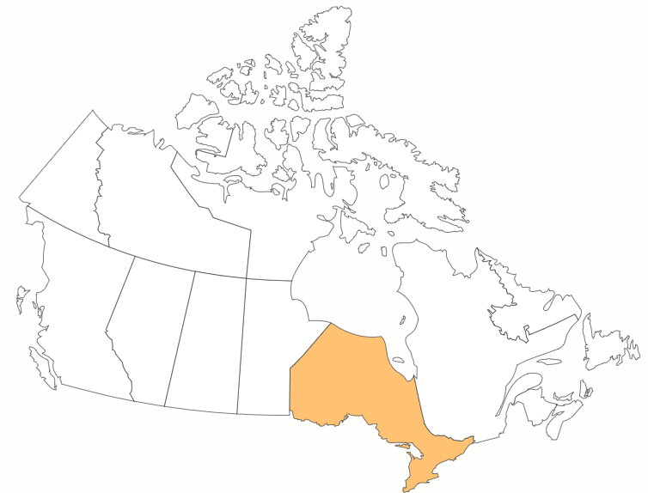
ONTARIO

Slide 5
ILLICIT – ONTARIO – QUARTERLY
Strong illicit performance in most recent 12 weeks driven by seasonal upswing that we typically see in Q2.

Slide 6
ONTARIO – QUARTERLY
Illicit pricing remaining stable.

Slide 7
ILLICIT ATTITUDES - ONTARIO
No significant changes in perceptions.

Slide 8
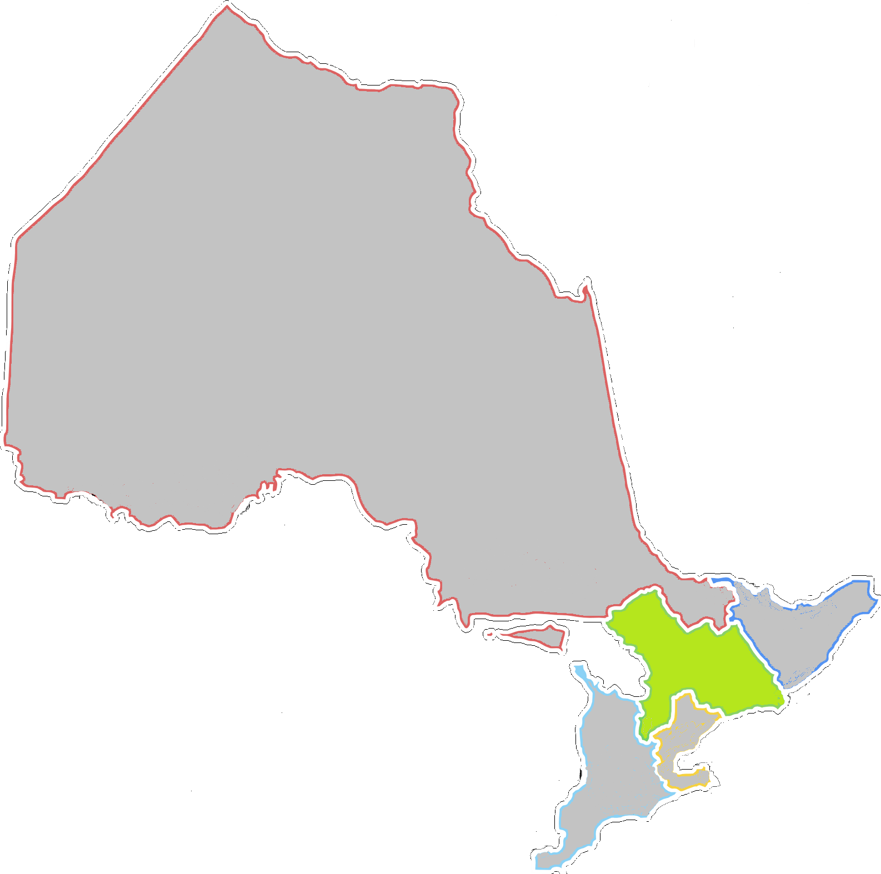
ROO

Slide 9
ILLICIT – ROO – QUARTERLY
ROO= Rest of Ontario (Ontario excluding GTA)
ROO helping drive upswing in P7D purchases.
.

Slide 10
ROO – QUARTERLY
ROO= Rest of Ontario (Ontario excluding GTA)
Prices stable.

Slide 11
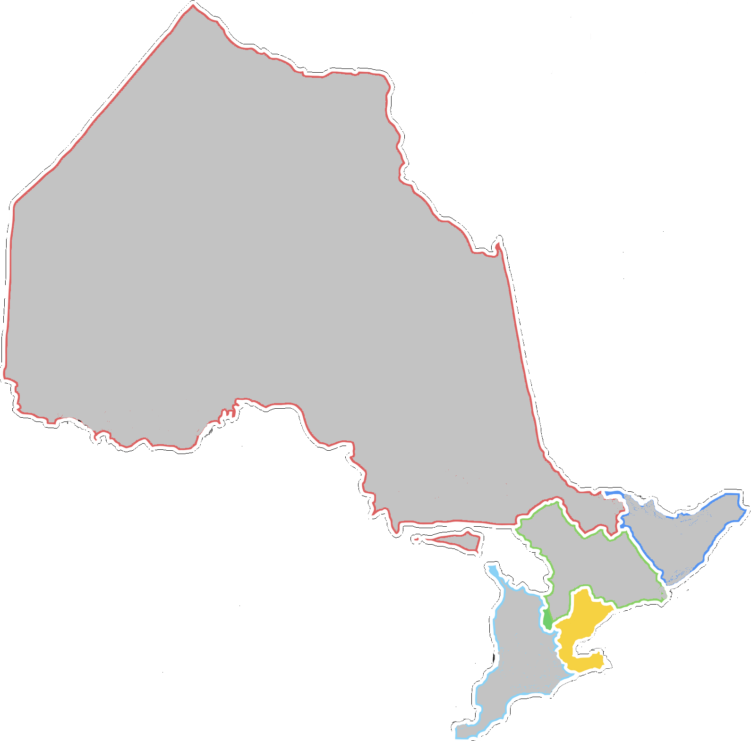
GTA

Slide 12
GTA – QUARTERLY
GTA – There is an upswing in GTA illicit purchases, but it is not being driven by reservation purchases which used to play a big factor in Illicit sales in GTA.

Slide 13
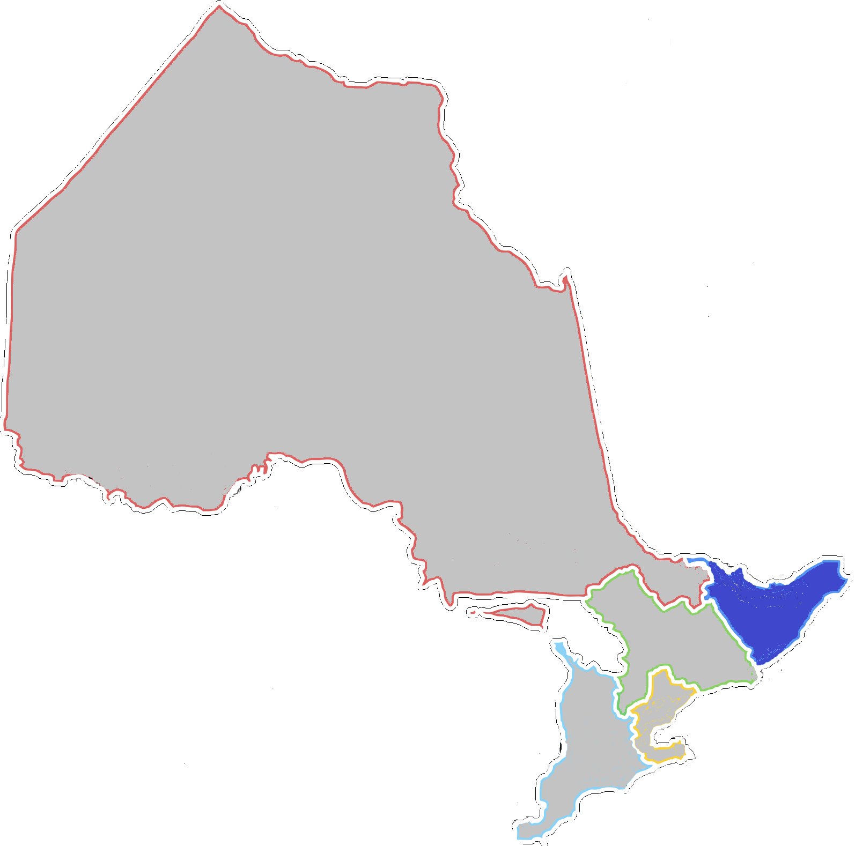
OTTAWA / Eastern Ontario

Slide 14
OTTAWA / EASTERN ONTARIO – QUARTERLY
Ottawa – Down slightly from the numbers we saw in Q1

Slide 15
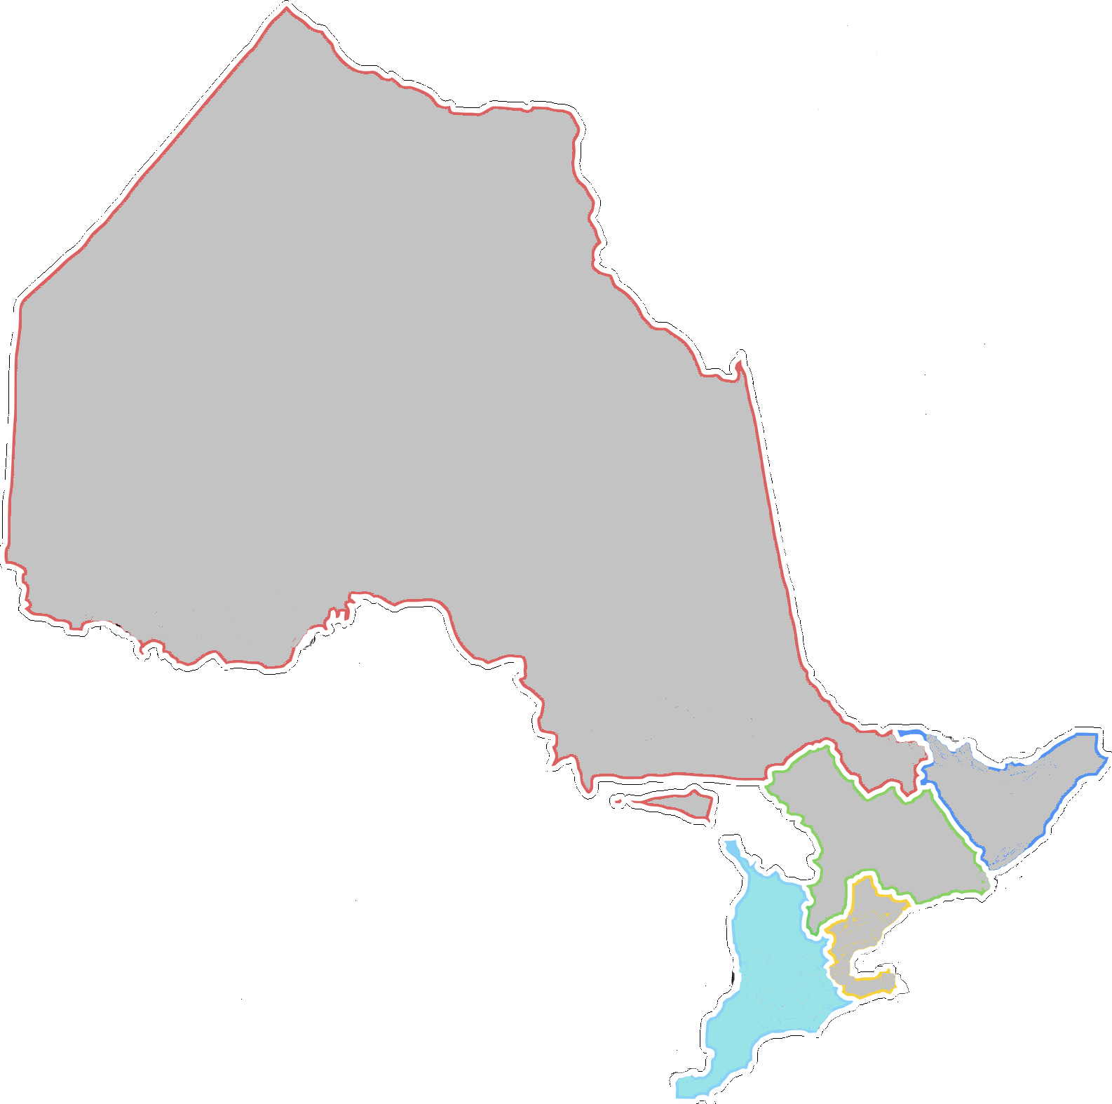
Southern Ontario

Slide 16
SOUTHERN ONTARIO – QUARTERLY
Southern Ontario P7D share number is showing increases.

Slide 17
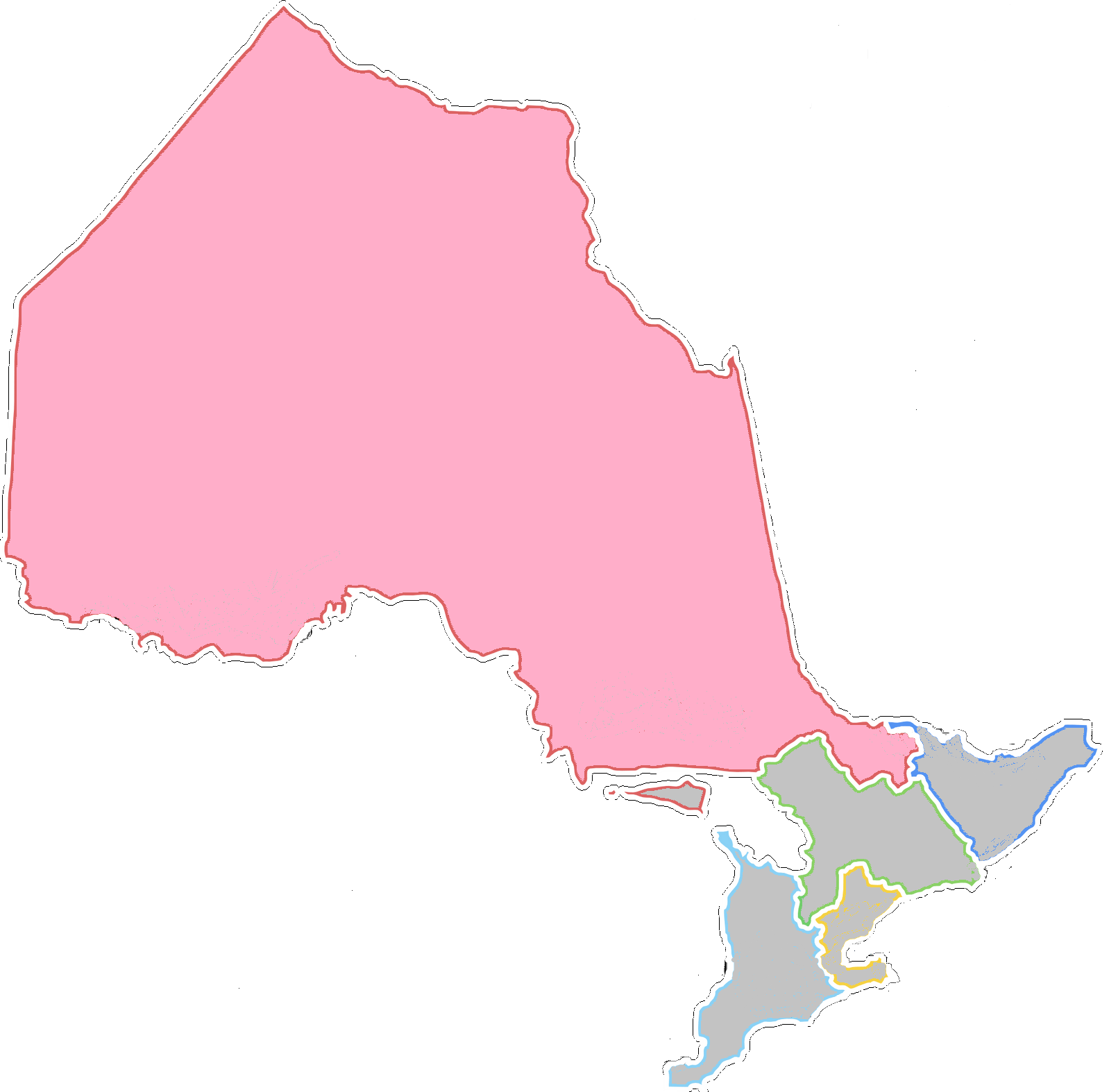
northern Ontario

Slide 18
NORTHERN ONTARIO – QUARTERLY
Northern Ontario – An increase in reservation purchases is driving a higher number.

Slide 19
ILLICIT ATTITUDES - ONTARIO

Slide 20
ILLICIT ATTITUDES – ONTARIO SUB REGIONS YTD 2019
Although GTA has been showing recent illicit growth it still lags behind the other regions of Ontario in both performance and perceptions.

Slide 21
ILLICIT ATTITUDES – ONTARIO (YTD 2019, 2018 & 2017)
Little change in attitudes towards illicit compared to previous years.

